Slide 1

Avocado Prices

Slide 2
Problem statement
Avocado has become one of the world's trendiest foods. According to the poster child of millennial healthy eating, this superfood is now a mainstay for foodies everywhere.
Avocado prices have rocketed in recent years by up to 129%, with the average national price of a single Hass avocado reaching $2.10 in 2019, almost doubling in just one year.
The main objectives of this study were to predict avocado prices using the data gathered by Hass Avocado Board (HAB) - a trade organization that provides industry professionals with research and data on avocado prices around the world.
Next is to find out pattern in attributes that affect the prices of avocados.

Slide 3
Data Description
Predicted attribute: Prices of avocados.
Number of instances: 33045
Number of Attributes: 13
Attribute Information:
date: The date of the observation.
average_price: The average price of a single avocado.
total_volume: Total number of avocados sold.
4046: Total number of avocados with PLU 4046 sold.
4225: Total number of avocados with PLU 4225 sold.
4770: Total number of avocados with PLU 4770 sold.

Slide 4
Data Description continued….
total_bags: Total number of bags sold.
small_bags: Total number of small bags sold.
large_bags: Total number of large bags sold.
xlarge_bags: Total number of extra-large bags sold.
type: Organic or conventional.
year: The year of observation.
geography: The city or region of the observation.
Missing Attribute Values: None

Slide 5
Approach
Steps of approach are as follows:
Extracting data from large dataset.
Exploratory Analysis.
Apply DMBI/ML Algorithms.
Visualizations and interpretation of results in R.
Result and Discussion.

Slide 6
Extracting data from large dataset
Extracting the data basically means cleaning the data.
Data cleansing is the process of preparing data for analysis by removing or modifying data that is incorrect, incomplete, irrelevant, duplicated, or improperly formatted.
This data is usually not necessary or helpful when it comes to analysing data because it may hinder the process or provide inaccurate results.
This process identifies incomplete, incorrect, inaccurate or irrelevant parts of the data and then replacing modifying, or deleting the dirty or coarse data.
Data cleansing may be performed interactively with data wrangling tools, or as batch processing through scripting.

Slide 7
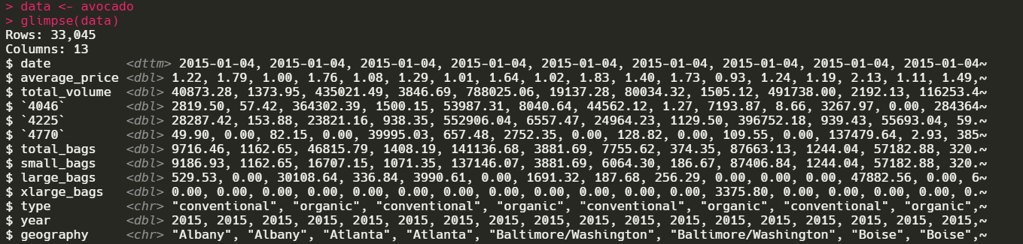
Glimpse of the data

Slide 8
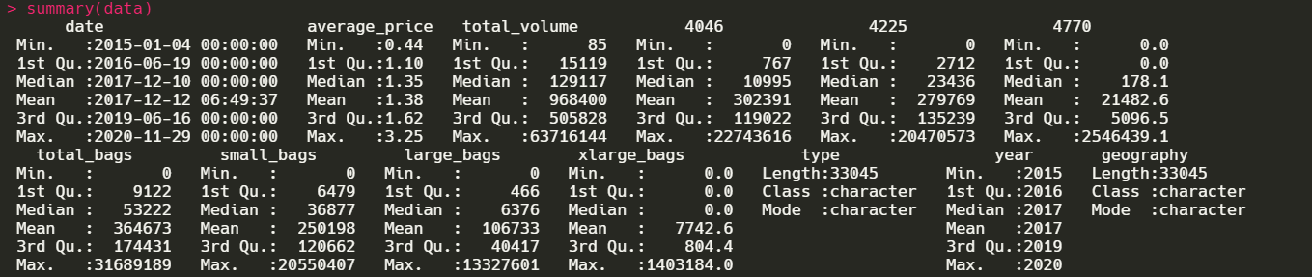
Summary of the attributes

Slide 9
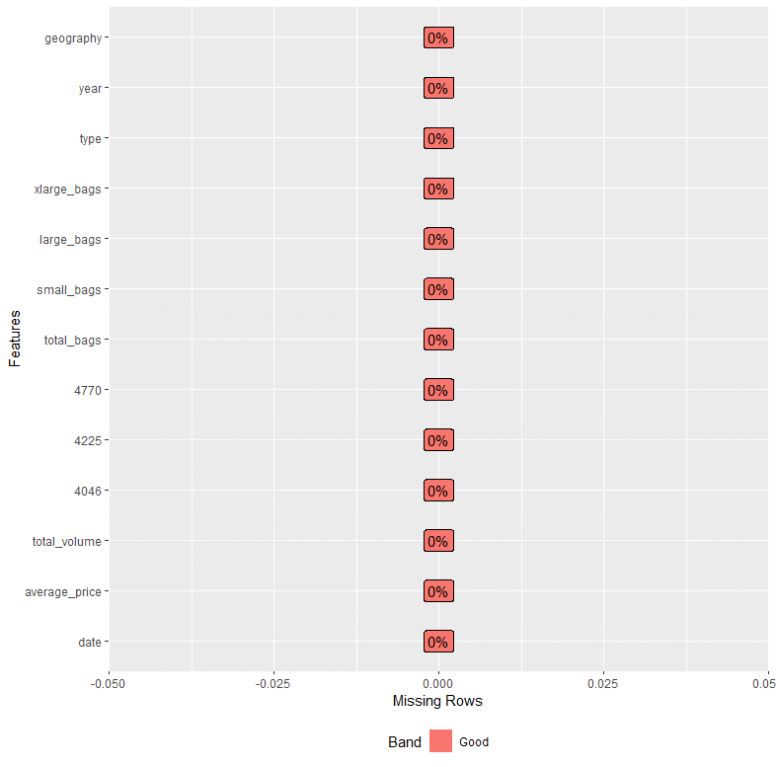
Missing values information

Slide 10
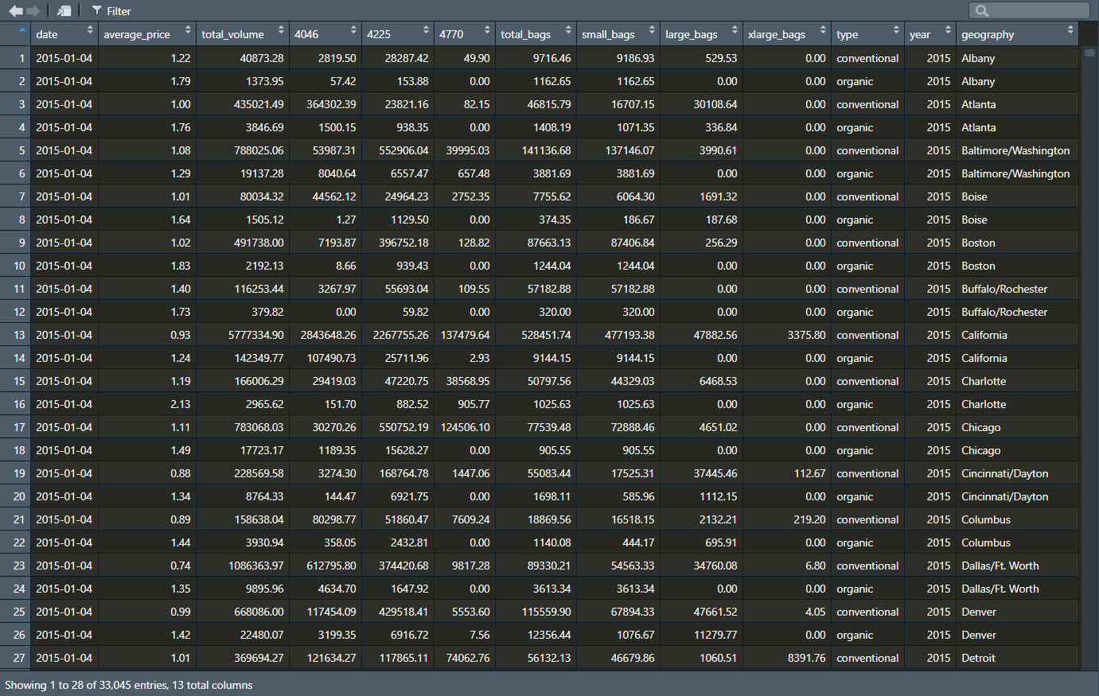
Fig: Cleansed tabular view of the dataset.

Slide 11
Exploratory Analysis
In this phase of the project, we will concentrate mainly on the seasonal pattern aspect of the time series forecasting analysis.
Seasonal Patterns: In this section we will focus on constant patterns that occur frequently from year to year and from month to month in both types of avocados conventional and organic.

Slide 12
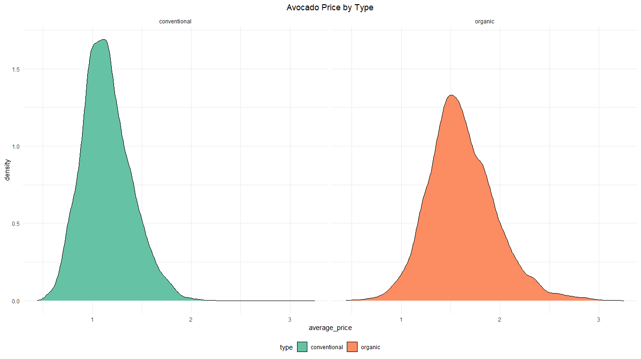
Fig: Density plots of different types of Avocados.

Slide 13
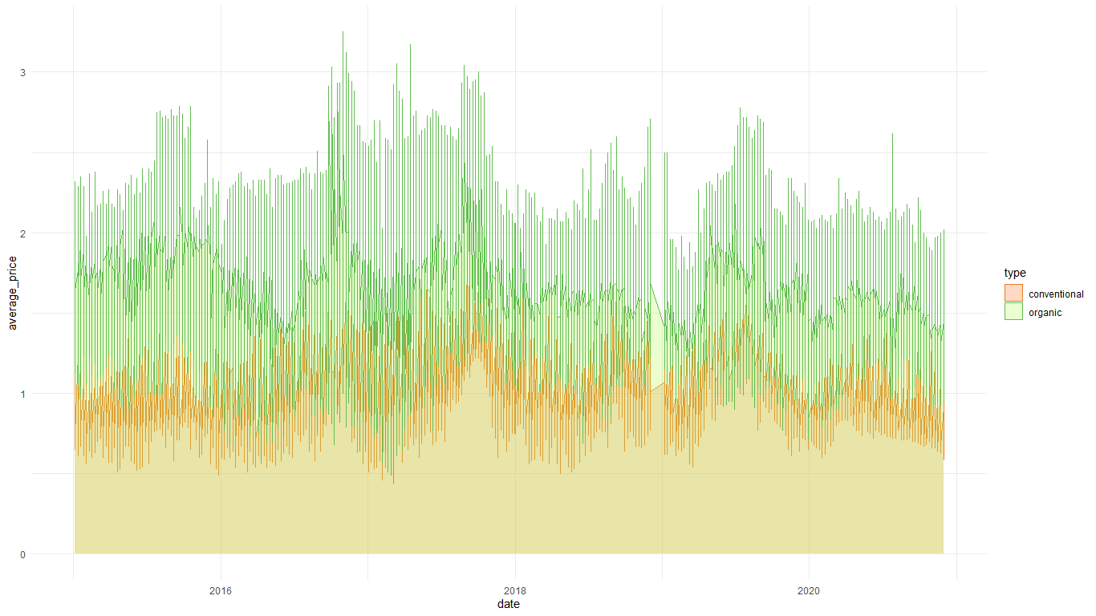
Fig: Range of average prices of avocados throughout the years.
Organic avocados: Based on the price changes throughout time we can see that they are more expensive.
Conventional avocados: Based on price changes throughout time we can see that they are less expensive.

Slide 14
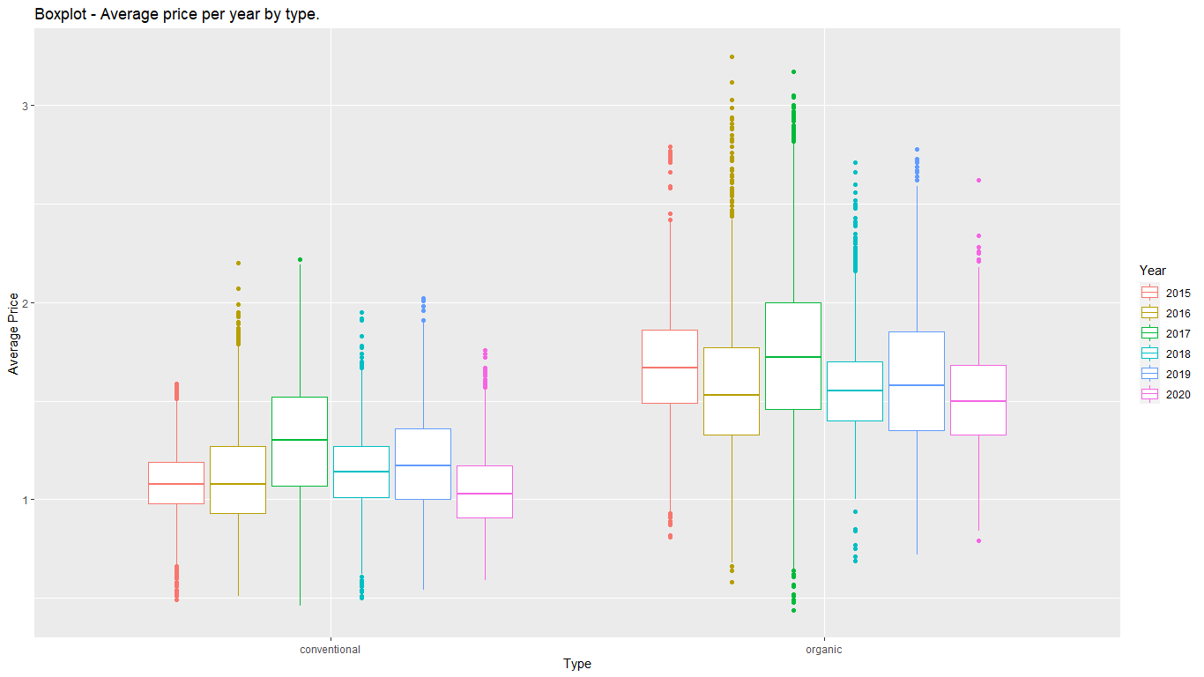
univariate Analysis:
Fig: Average price of avocados per year by type of avocados.

Slide 15
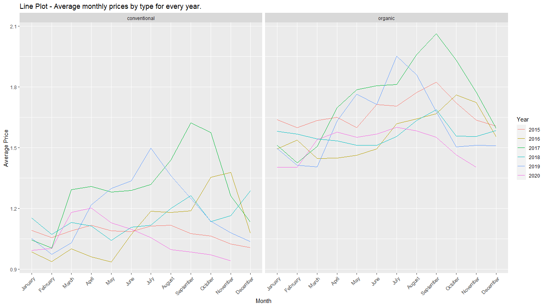
Fig: Average price of avocados per month by type of avocados for every year.

Slide 16
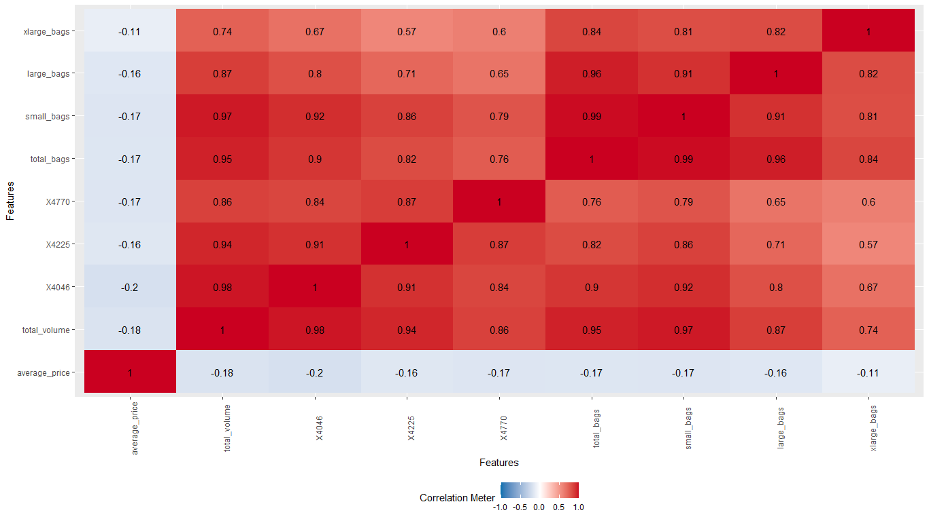
Multivariate Analysis:
Fig: Correlation heatmap for all the continuous categories.

Slide 17
Apply DMBI/ML Algorithms
Different types of algorithms used are:
Linear Regression.
Decision Tree.

Slide 18
Linear Regression
Linear regression is one of the most commonly used predictive modelling techniques to predict the value of a continuous variable Y based on one or more input predictor variables X.
The aim is to establish a mathematical formula between the response variable (Y) and the predictor variables (X’s).
Linear regression model can be used to learn which features are important by examining coefficients. If a coefficient is close to zero, the corresponding feature is considered to be less important than if the coefficient was a large positive or negative value.
That’s how the linear regression model generates the output. Coefficients are multiplied with corresponding input variables, and in the end, the bias (intercept) term is added.

Slide 19
Linear Regression steps
Step 1: It is observed in the dataset that the price of avocados goes down as volume sold goes up. Test if this relationship is statistically significant.
library(sjPlot)
library(ggfortify)
library(readxl)
# Import the dataset.
avocado <- read_excel("avocado.xlsx")
data = avocado
conmod <- data %>%
filter(type == "conventional") %>%
mutate(Volume = log(`total_volume`)) %>%
lm(average_price ~ Volume, data = .)

Slide 20
Linear Regression steps
orgmod <- data %>%
filter(type == "organic") %>%
mutate(Volume = log(`total_volume`)) %>%
lm(average_price ~ Volume, data = .)
Save the model in order to display the results in a table. Use the tab_model function from the sjPlot package for this purpose.
# Printing the output in a table rather than in the console.
tab_model(conmod, orgmod)

Slide 21
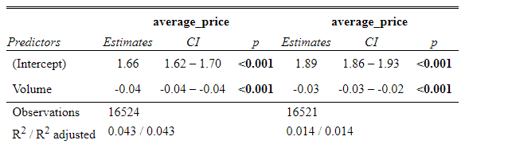
Visualizations and interpretation of results in R: Linear regression
Fig: Tabular data showing the relation between average avocado prices and volume.

Slide 22
Linear Regression steps
Step 2: Regression Diagnostics
Examine if the fitted model is any good with autoplot and ggfortify. This will give a ggplot2 version of the regression diagnostics plot from base R.
#Regression diagnostics.
autoplot(conmod)
autoplot(orgmod)

Slide 23
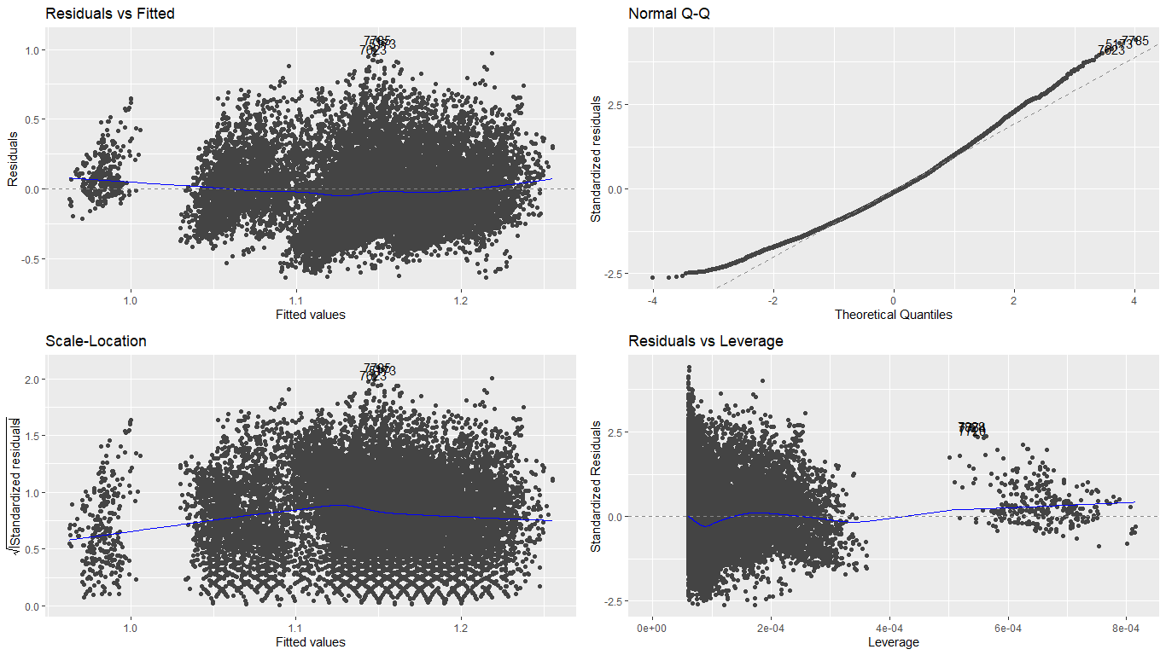
Fig: Regression diagnostic plots for the conventional avocados.

Slide 24
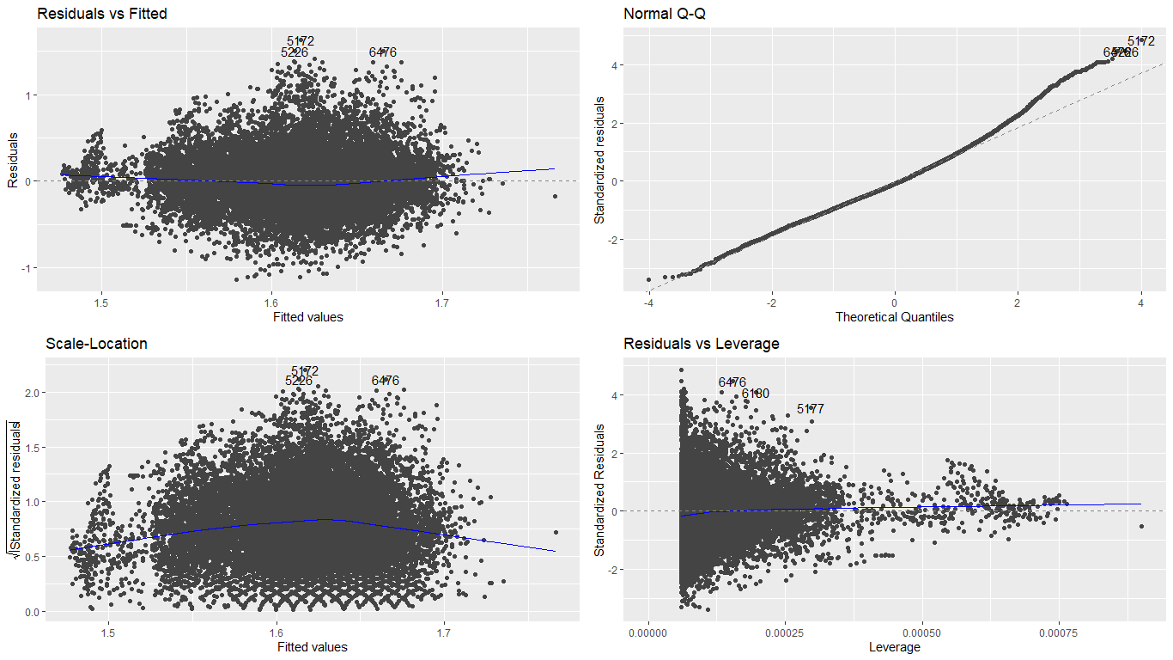
Fig: Regression diagnostic plots for the organic avocados

Slide 25
Result and Discussion: Linear Regression
Observations claiming the relationship between avocado prices and volumes where prices go down with increase in volumes sold were confirmed by the results. The p-value is shows that the negative coefficient is statistically significant.
It is observed from the Linear Regression plots, for both type of avocados (conventional and organic), that the model roughly follows a normal distribution as the deviations are not too steep.
Furthermore, the standard deviation of the residuals does not exceed 3 and are mostly below 2. We can therefore conclude that the price of avocado drops as volume increases.

Slide 26
Decision Tree
Decision tree is a type of supervised learning algorithm that can be used in both regression and classification problems.
It works for both categorical and continuous input and output variables. It builds classification models in the form of a tree-like structure, just like its name.
It is also used to create data models that will predict class labels or values for the decision-making process. The models are built from the training dataset fed to the system (supervised learning).
Using a decision tree, we can visualize the decisions that make it easy to understand and thus it is a popular data mining technique.

Slide 27
Code for decision tree
library(rsample) # Data splitting.
library(dplyr) # Data wrangling.
library(rpart) # Performing regression trees.
library(rpart.plot) # Plotting regression trees.
library(readxl)
# Import the dataset.
avocado <- read_excel("avocado.xlsx")
# Drop the geography column.
data = avocado[, 1:12]
# Splitting the dataset in a 0.7 ratio by default order by years.
avocado_train = data[1:23131,]
avocado_test = data[23132:33045,]
# Regressor.
m1 <- rpart(formula = average_price ~ ., data = avocado_train, method = "anova")
print(m1)

Slide 28
Code for decision tree
# Summary of the decision tree regressor.
summary(m1)
# Plotting the tree.
rpart.plot(m1)
plotcp(m1)
# Predicting prices for the test split.
predictions <- predict(m1, avocado_test, type = 'vector')
# Summarizing accuracy.
# Calculating the Root Mean Squared Error.
RMSE(predictions, avocado_test$average_price)

Slide 29
Code for decision tree
# Calculating the Mean Squared Error.
mse <- mean((avocado_test$average_price - predictions)^2)
print(mse)
# Calculating the Mean Absolute Error.
MAE = function(actual, predicted) {
mean(abs(actual - predicted))
}
print(MAE(avocado_test$average_price, predictions))

Slide 30
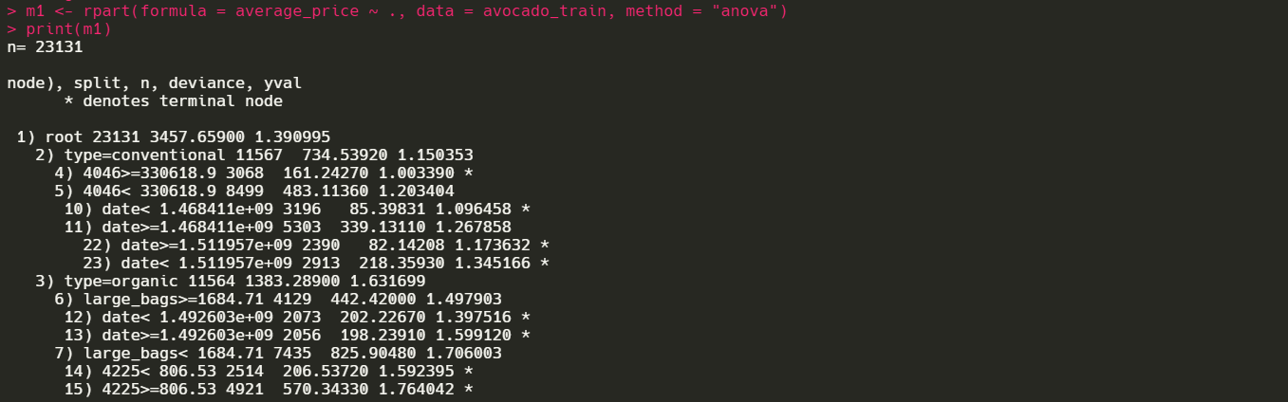
Visualizations and interpretation of results in R: Decision Tree.
Fig: Decision tree regressor model.

Slide 31
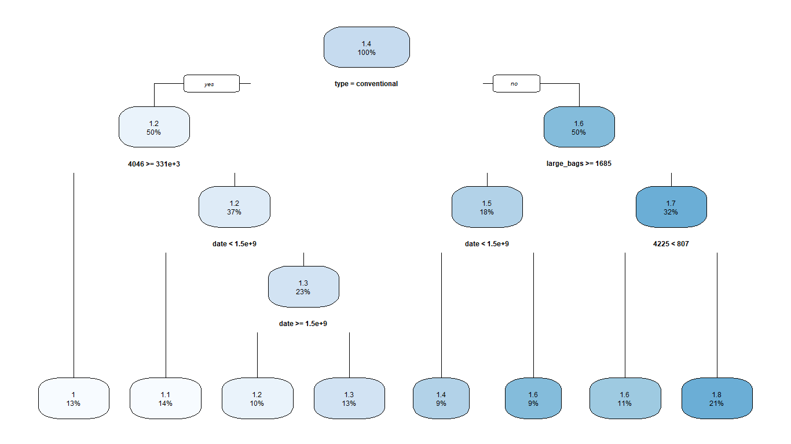
Fig: Visualizing the decision tree regressor model.

Slide 32
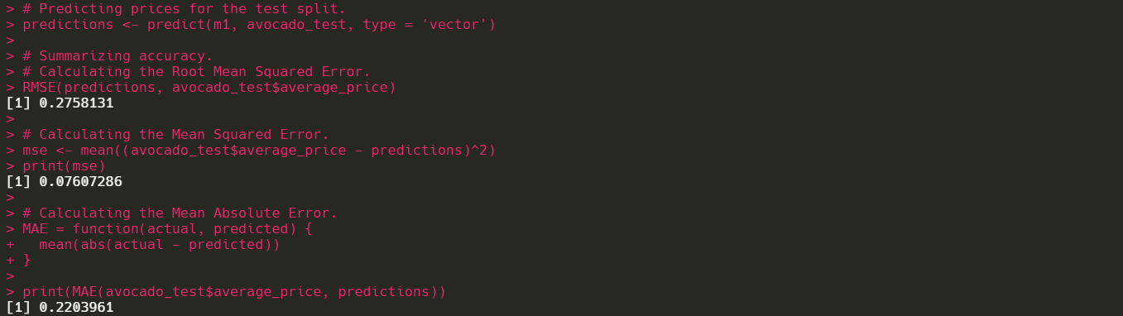
Fig: Summarizing accuracy with RMSE, MSE and MAE.

Slide 33
Result and Discussion: Decision Tree
A decision tree is one of the most common classification algorithms that are implemented. The avocado dataset was first split in the ratio 0.7 for training and testing sets.
The decision tree implemented in this project was plot on the training dataset. From the testing set, predictions were calculated.
To summarize the accuracy of the model, different errors like Root Mean Squared Error, Mean Squared Error, Mean Absolute Error were calculated.
MSE resulted in a 0.076 which is much closer to 0, indicating that the predictions were significantly accurate and closer to the actual values in the testing set.
Lower values of MSE indicate good predictions, the closer the MSE is to 0, the accurate the prediction is.

Slide 34
Conclusion
From the Linear Regression plots, for both type of avocados (conventional and organic), we conclude that the model roughly follows a normal distribution as the deviations are not too steep (less than 2.5). We therefore conclude that the price of avocado drops as volume increases.
Decision Tree Regression model was implemented to predict the average prices of the avocados. Different errors were calculated to test the accuracy. They are:
Root Mean Squared Error = 0.2758
Mean Squared Error = 0.0760
Mean Absolute Error = 0.2209

